Slide 1
Measuring
21/02/2024
Year 7 Science

Slide 2
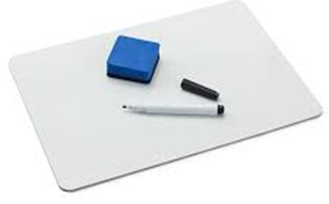
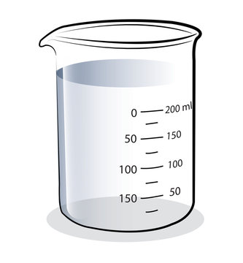
Review: Name these
1.

Slide 3
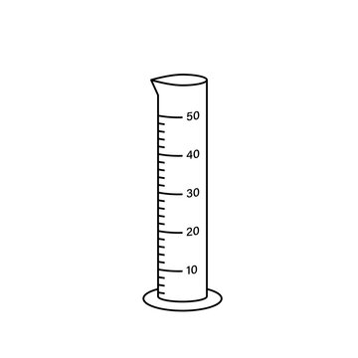
Review: Name these
2.

Slide 4
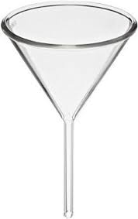
Review: Name these
3.

Slide 5
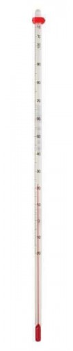
Review: Name these
4.

Slide 6
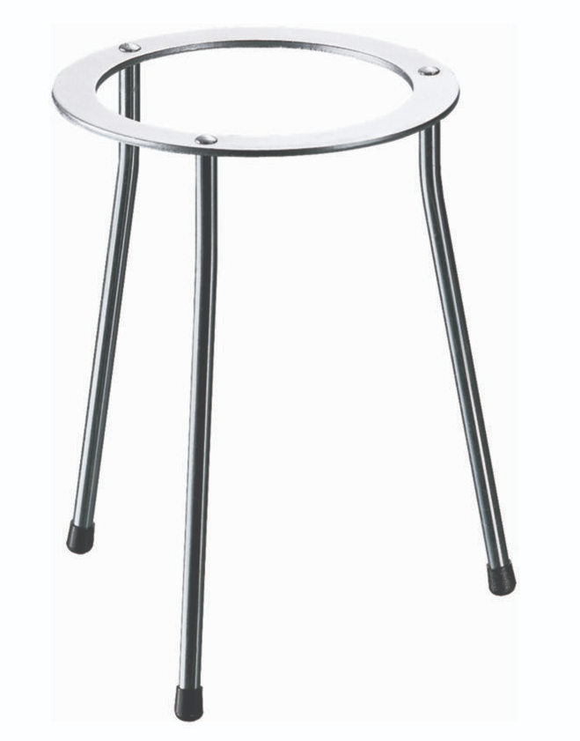
Review: Name these
5.

Slide 7
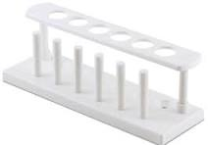
Review: Name these
6.

Slide 8
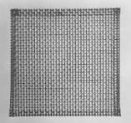
Review: Name these
7.

Slide 9
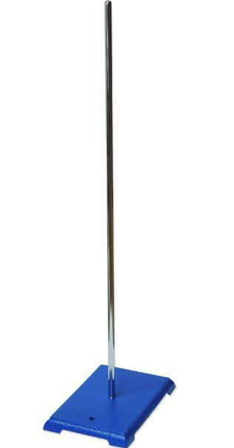
Review: Name these
8.

Slide 10
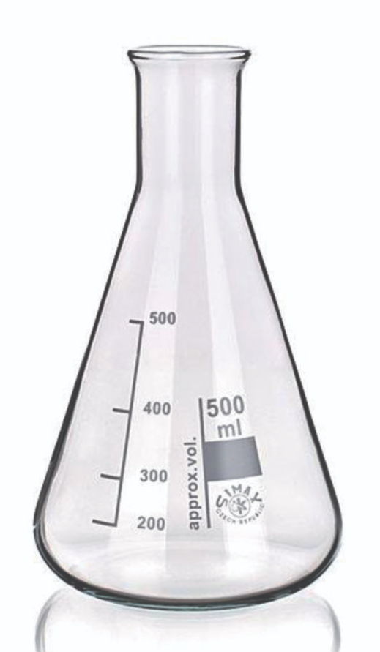
Review: Name these
9.

Slide 11
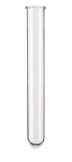
Review: Name these
10.

Slide 12
Learning Intentions
Conduct experiments, ensuring safety and ethical guidelines are followed

Slide 13
Success criteria
Use measuring equipment safely
Use correct units for measurements
Record data in tables

Slide 14
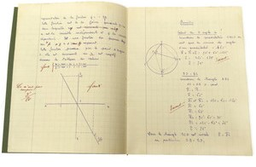
Measuring Date: 21/02/2024
Measurement | Units | Measurement | Units
1 |  | 7
2 |  | 8
3 |  | 9
4 |  | 10
5 |  | 11
6 |  | 12

Slide 15
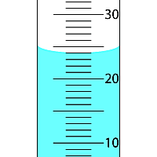
Measuring liquids
meniscus

Slide 16


Slide 17


Slide 18
Success criteria
Use measuring equipment safely
Use correct units for measurements
Record data in tables

Slide 19
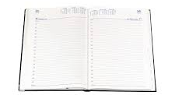
Don’t forget
Homework sheet – laboratory equipment
Due Monday 12 Feb

